Slide 1
Winery Cleaning Equipment
12/11/09
Joe Lutomske
enotools.com

Slide 2
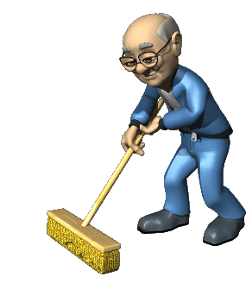
Definition of a Winemaker:
www.thfreedictionary.com
Noun1.winemaker : someone who makes wine
Andrew Meggitt, Winemaker, St. James Winery defines as, “A guy (or girl) who spends half his time cleaning”.

Slide 3
Why Clean?
Improve product quality
Prevent microbial issues
Reduce the likelihood of cross-contamination between batches
Minimize or eliminate shielding residues or coatings which harbor anaerobic microbes/ bacteria.
Increased productivity
Improved employee safety and morale

Slide 4
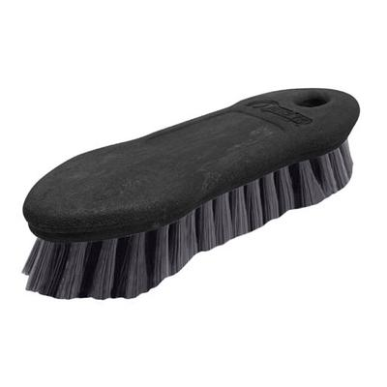
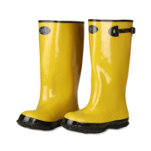
Clothing/ Equipment
Chemicals
Waterproof Boots, clothes, and gloves.
Buckets
Scrub Brushes
Lots of running water- Cold and Hot
Pressure Washer
Spray ball or tank/ barrel washer
Wash- Down Hose
Steam Generator ?
Ozone ?

Slide 5
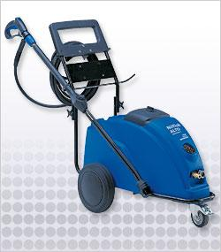
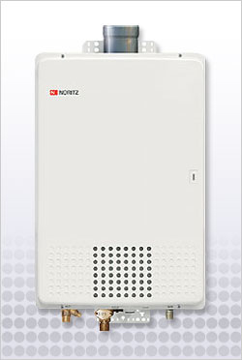
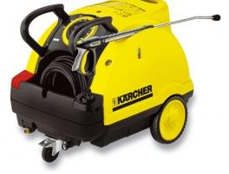
Pressure Washers & Hot Water
+
=
Aaquatools KEW Poseidon 7
$4500.00
Bullet- Proof and will get things CLEAN
Aaquatools
Noritz 132M
$4199
Greener.
LP gas or Propane
All brands- Hot carts, etc. $3000-$9000
Pro: Convenient.
Cons:
Diesel Fumes or Electric Hungry

Slide 6
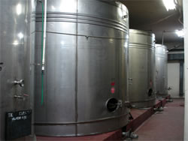
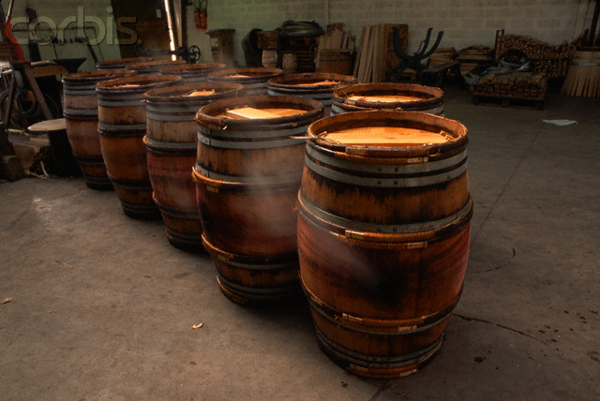
Areas of the Winery to be Cleaned
Tank Room
Barrel Room
Bottling Room
Crushpad
Restrooms
Parking Lot
Tasting Room
Warehouse

Slide 7
Tank Room
Floors, walls, ceiling, tanks, hoses, hardware, heat exchanger-
Before and after crush, transferring wine
Hot and cold water
Pressure Washer
Hot Water Heater
Hose Pigs
Tank Cleaner

Slide 8
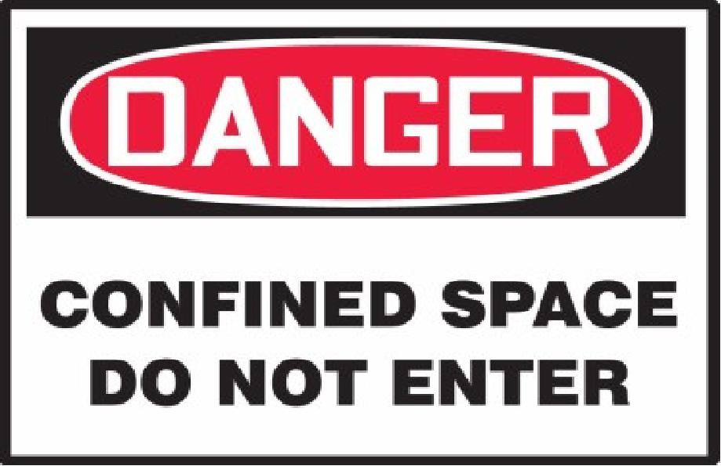
Cleaning Tanks

Slide 9
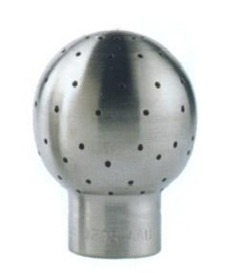
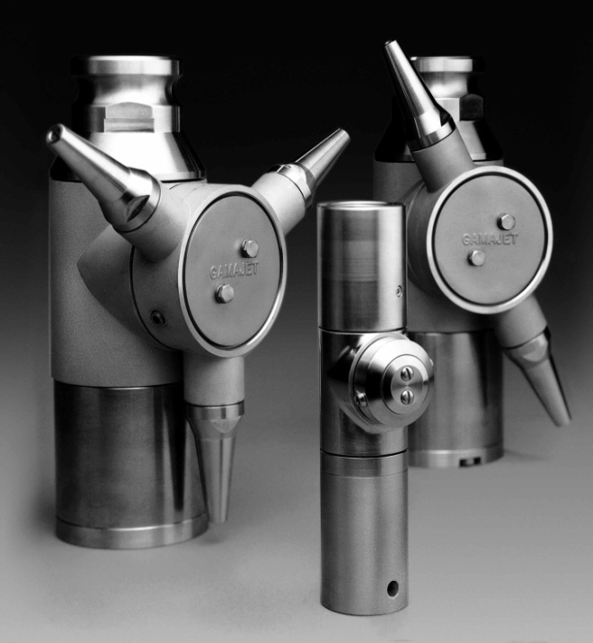
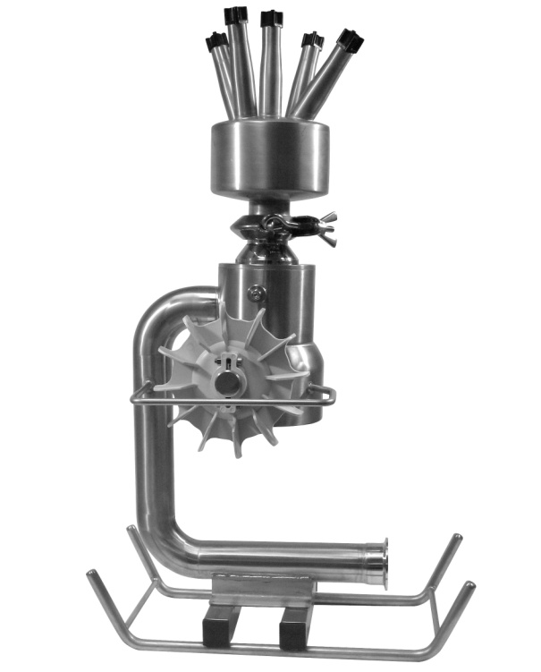
Tank Cleaners : The Price Ranges
Cost: $150-$300
High Flow Low Pressure. Pump Driven.
Use with chemical. Recirculate Water
Cost: $1800
Uses your existing pump to recirculate
Effective, if chemical is used. Saves water.
Cost : $2500-$4500
Requires $4,500 pressure washer.
VERY effective. Not water saving.

Slide 10
Bottling Room & Equipment
Bottling lines require strict sanitation for preventing the spread of:
TCA- cork, bottle boxes, or corker jaws, bottle dust
Spontaneous fermentation (Sparkling Baco)
“Brett”
Any other issue stemming from good wine rinsed through dirty equipment.
Cleaning methods:
Manual Labor
Steam
Ozone
Chemicals

Slide 11
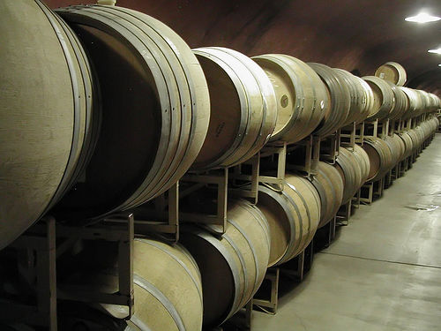
Barrel Room
The barrel room should not smell like a cave!
(“Great Fruit. What a nice vineyard. Interesting.”)
Any time moisture, chlorine, and wood/ paper particles meet: hello, TCA
Avoid using pressure treated wood
Clean the room itself
Clean the barrels
SANITIZE the wine thief between uses; Every time!

Slide 12
Barrel Cleaners 1
How do you clean your barrels?
(Water, ozone, steam, sulphur, chem- tab?)

Slide 13
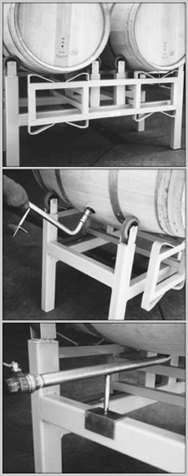
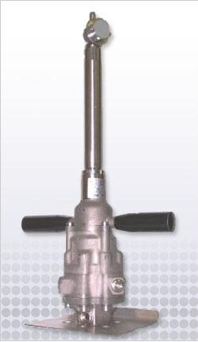
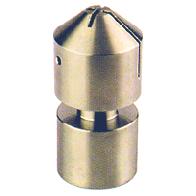
Barrel Cleaners 2
Carlsen Spray Ball
With wand, $300.00
Pump- driven
Aaquatools 360
$2800.00
Requires pressure washer

Slide 14
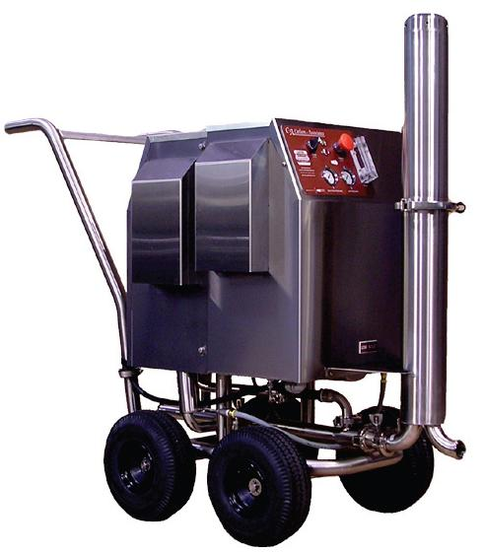
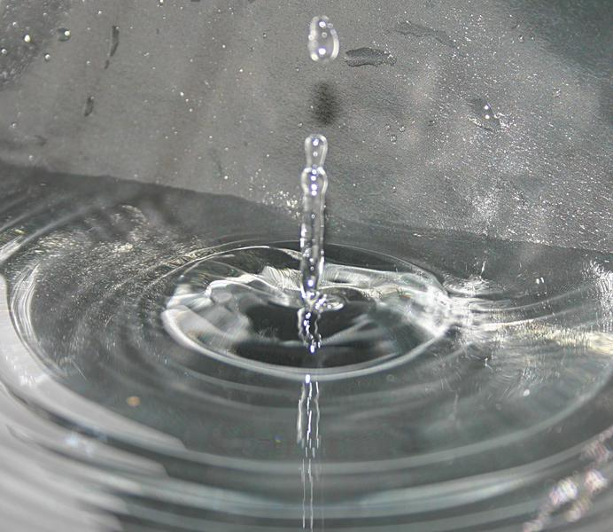
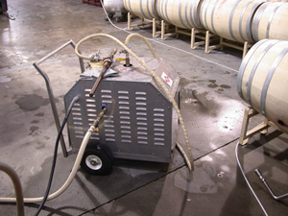
Bottling Line Cleaning/ Sanitizing
-Hot Water, Ozone*, or Steam?
Cost Unknown
Hot water
160 – 200 degrees f
30 – 15 minutes
Wastes water
Ozone
$1,200- $11,000
Fastest
Medium water use
*Only kills what it touches
Steam Generator
$1200- $4500
Dangerous to flesh
Lower water consumption
15 minutes

Slide 15
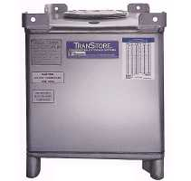
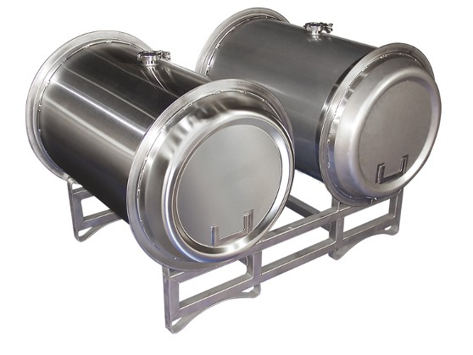
Not All Barrels are Wood

Slide 16
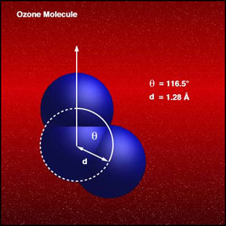
Ozone
Test the machine on YOUR water
Warranty?
Service?
Training?
REFERENCES

Slide 17
Q&A

