Slide 1
OZONE:
Oxygen Gone Wild
Joe Lutomske

Slide 2
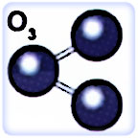
Part 1
What is Ozone?

Slide 3
What is Ozone?
Synonyms: Triatomic oxygen
CAS No.: 10028-15-6
Molecular Weight: 48.0 Heavier than CO2!
Chemical Formula: O₃
Delivered in bubbles by water
Gaseous
Blue
Unstable
Smells like lightning

Slide 4
Is Ozone Safe?
MSDS
OSHA
Hazard? Yes.
Inhalation: Causes dryness of the mouth, coughing, and irritates the nose, throat, and chest. May cause difficulty in breathing, headache, and fatigue. The characteristic sharp, irritating odor is readily detectable at low concentrations (0.01 to 0.05 ppm).
Hazard? No.
OSHA Permissible Exposure Limit (PEL) for General Industry: 29 CFR 1910.1000 Z-1 Table -- 0.1 ppm, 0.2 mg/m³ TWA (8 hour shift)
Aggravates Asthma
Health Effects: Irritation-Eyes, Nose, Throat, Skin---Marked (HE14); Lung edema (HE11), Cumulative lung damage (HE10), Respiratory sensitization (HE9).
Fatal at 5ppm

Slide 5
What Is It Good For?
Ozone is the most reactive substance known
Ozone instantly annihilates enzymes, microbial membranes and unpleasant taste- and odor-causing compounds.
Ozone destroys on contact all known bacteria, virus, molds, spores, yeast, mildew, microscopic fungi and biofilms (toughened colonies of microorganisms on surfaces).
Ozone kills microbes much faster than weaker oxidizers like chlorine—up to 5,000 times faster. But unlike chlorine, ozone oxidation leaves no harmful or foul byproducts and residue only oxygen.

Slide 6
How Can Wineries Use Ozone?
For Sanitizing and Deodorizing
Part of a barrel cleaning program
Tank rinse
Floors, walls, drains, ceilings
Bottling line rinse

Slide 7
Enemies of Ozone
Natural Rubber
Your favorite boots
Old hoses
Bacteria causing Nail polish remover, band- aid, vinegar, sweaty horse, ball- glove, mousiness, rancid peanut butter, geranium, etc. in your wine.

Slide 8
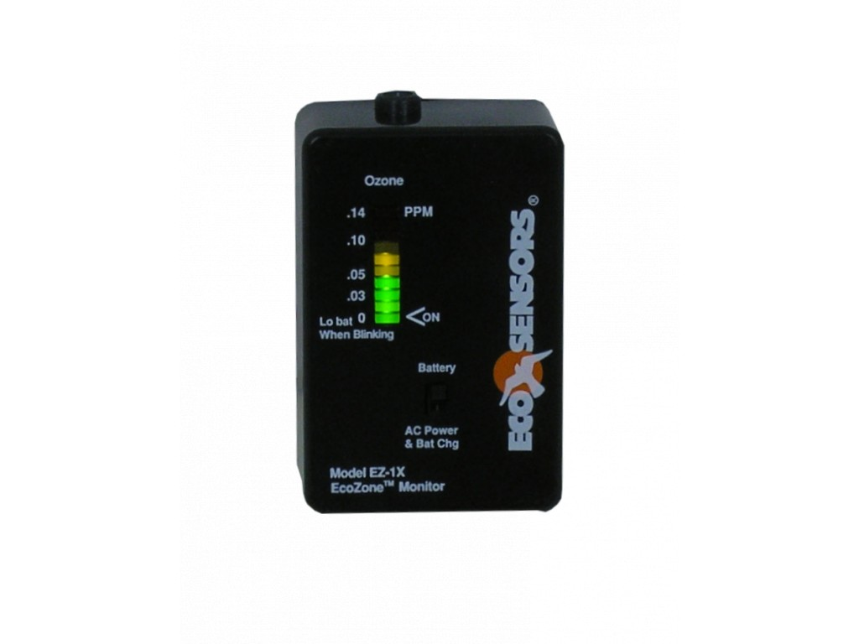
C.Y.A.

Slide 9
Part 2
Shopping for Ozone

Slide 10
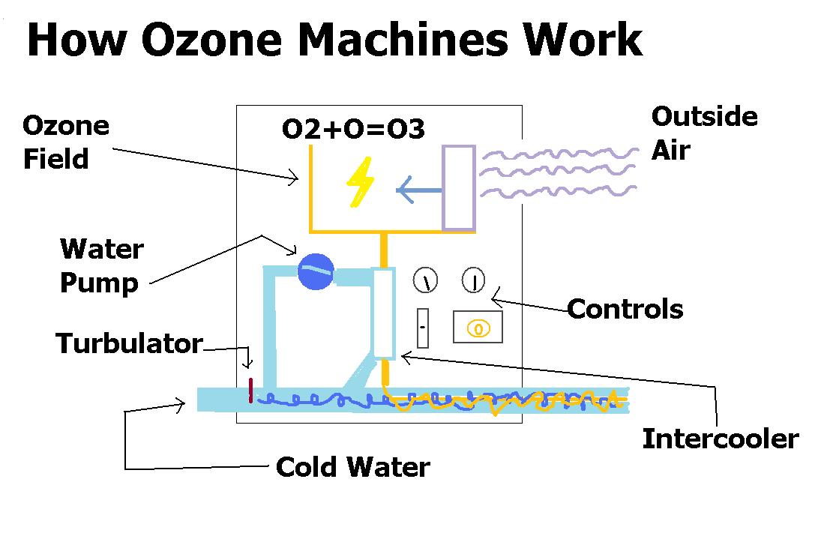

Slide 11
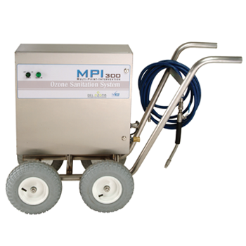
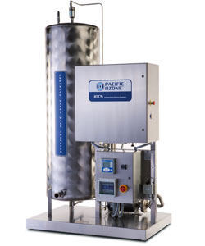
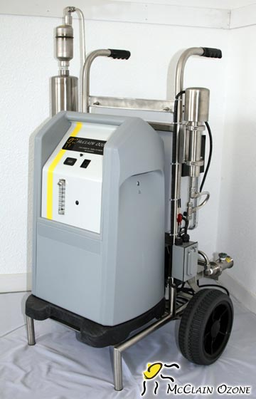
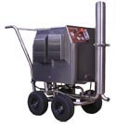

Slide 12
Ozone Suppliers
Carlsen & Associates
McClain Ozone
Del Ozone

Slide 13
Conclusion
Q&A Time!!

